Slide 1
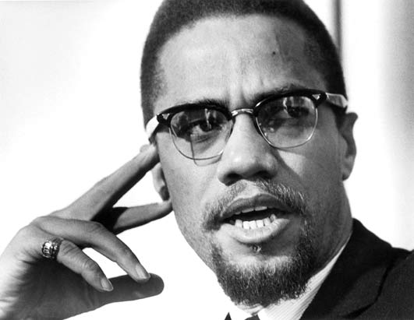
Week 5 Media and cultural change
“The media is the most powerful entity on earth. They have the power to make the innocent guilty and to make the guilty innocent, and that’s power. Because they control the minds of the masses.”
Malcolm X, African leader, 1925-1965
Guest Speaker: Dr Scott Downman
COMU7311, Semester 1, 2021
School of Communication and Arts
The University of Queensland

Slide 2
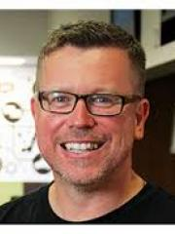
Guest speaker
Dr Scott Downman is a lecturer in journalism in the School of Communication and Arts at the University of Queensland. He investigates the coverage of refugees, asylum seekers, the victims of human trafficking and other vulnerable people and explores how their voices are covered within the media. Scott’s book, Hyperlocal journalism and digital disruptions: The journalism change agents in Australia and New Zealand, published by Routledge in 2018, argues for the increased importance of new forms of localised reporting in the digital age. In 2015, Scott led a team of 10 journalism students to initiate a Change Makers magazine project, with Woodridge State High School. The project aimed to debunk negative stereotypes and showcase real stories that promote pride, hope and inspiration of the local community. The team won the Communication and Media Achievement Award at the Queensland Multiculural Awards.

Slide 3


Slide 4
Learning objective
After this lecture, you should be able to:
Appreciate the influence of media on cultural change.

Slide 5
Media-constructed reality
Three types of social realities:
Objective social reality – the outside world of actual events.
Symbolic social reality – our mediated knowledge of those events.
Subjective social reality – individuals’ perception of the world.

Slide 6
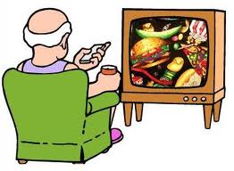
Research on media effects
Agenda setting theory
Cultivation hypothesis
Two step flow and muti-step flow theory

Slide 7

Mass media and cultural change
Media create awareness.
Media set agendas.
Media promote/reduce stereotypes.
Media accelerate change.

Slide 8
Research on media users
Uses and Gratifications theory asks how people use the media and what they gain from their interaction with various media forms.
For example, media use in creating migrant cultural identity examines the ways in which migrants typically make use of various forms of mass media to create new identity in their host country.

Slide 9
Cultural studies
Cultural studies approach is interested in the role culture plays in both preserving and transforming social relations.
Cultural studies scholars tend to focus on those popular (media) cultural forms that are not traditionally studied in academic settings (e.g., popular TV shows, rap music, and romance novels).

Slide 10
Social media and journalism
Social media, particularly Twitter, offers development for future journalism. The use of Twitter by journalists and audiences blurs the boundary between media producer and consumer.

Slide 11
After class …
Select two online newspapers of different ownership. For 5 days, read its front-page stories. Construct a table to record the stories under categories of international, national and local news items. Write down your answer to the question: Is there a relationship between media ownership and the types of stories covered in the two newspapers?

Slide 12
Next week…
In Week 6, we will discuss human relationships, and building intercultural relationships

